Slide 1
Extending AI Agents with Azure Functions
Eamon O’Reilly & Nick Greenfield

Slide 2
Azure Functions Capabilities for Intelligent Apps
Real-time data ingestion at scale for RAG
Agent function tool calling
Orchestration with durable functions
Built-in capabilities
Flexible
Frameworks
Azure AI SDKs
Semantic Kernel
LangChain
LlamaIndex
AutoGen
OpenAI triggers & bindings
Language support
.NET / Python / Java / JavaScript / TypeScript / PowerShell
Notes:
built-in features and scenarios that we have support for today. Real-time data ingestion at scale for RAG Azure Functions makes it easy to integrate your data into RAG apps.
You can connect to many existing data sources and bring them into a backend like AI Search or Cosmos DB in real-time and at scale
Agents calling Functions as a tool
- Extend LLMS with agent tool calling.
Native integration with the Azure AI Agent service.
Allows you to build additional capabilities in Azure Functions and expose them within your agents.
Orchestration of AI Agents
- You can use DF to orchestrate how your agents are built and how they work together.
- You get easy programming model, built-in durability for LLM inputs and outputs assuming those calls are implemented as activity functions. Toyota recently published a case study on using Durable to orchestrate their multi-agent solution Frameworks.
With Functions, you can use any framework and language you're comfortable with, like PowerShell, Python, .Net, Java, JS, and TypeScript, to build AI solutions. Quick show of hands, is anyone using Functions for these scenarios today? Any others not mentioned?"

Slide 3
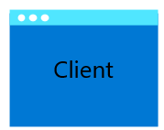




Async function calling with Azure AI Agent service https://learn.microsoft.com/en-us/azure/ai-services/agents/how-to/tools/azure-functions
Orchestration of function calling performed by Azure OpenAI
Client calls Azure AI Agent service
What is the weather in Tacoma, WA?
The weather is 75 degrees and sunny
Call Track shipping function to process request
Function calling information placed on storage queue with correlation id
Weather service
Function
The weather is 75 degrees and sunny
The weather is 75 degrees and sunny
Function return information placed on storage queue with correlation id when weather function completes
Get weather

Slide 4
Azure Functions MCP server hosting Early Preview - https://github.com/Azure-Samples/remote-mcp-functions-dotnet
MCP bindings : Developers can easily develop, test, and deploy remote MCP servers directly on Azure Functions using first-class inner-loop to outer-loop capabilities.
Scale: Built to scale MCP functions from 0 to 1000 instances fast
Hosting flexibility: Will be able to run MCP servers on local machine, Flex Consumption, Premium Functions, App Service, and Azure Container Apps
Language support: Use Node.js, Python, .NET (C#), Java, and PowerShell
Security: Use Functions keys, OAuth, managed identity, and network isolation
Complex tool functions: Support for orchestration, long running, or stateful requirements using durable functions

Slide 5
Async function calling with MCP hosted on Azure Functions https://github.com/Azure-Samples/remote-mcp-functions-dotnet
Azure AI Agents
Azure Functions MCP Server
What is the weather in Tacoma, WA?
Weather service
Function
The weather is 75 degrees and sunny
Get weather

Slide 6





Stateful patterns with Durable Functions
Function chaining
Async HTTP APIs
Fan-out/fan-in
POST
202
Durable Backends
Durable Task Scheduler (Preview)
Azure Storage
MSSQL
Monitor
Human interaction
Event aggregation
Notes:
Today, I'll be covering Durable Functions, more generally, Durable Execution and how it can provide value in intelligent app scenarios, particularly when developing with AI agents.
For those who haven't heard of Durable Functions that’s an extension of Azure functions that enables developers to write and chain stateful functions easily through a programming model. It provides support for implementing a bunch of different app patterns that require stateful chaining.
Durable makes it easy to build complex, long-running, and fault-tolerant applications.
I’ll also be using the new Durable Task Scheduler as the Durable Functions backend, which recently went to public preview and provides a bunch of neat features that we’ll see in just a bit.

Slide 7
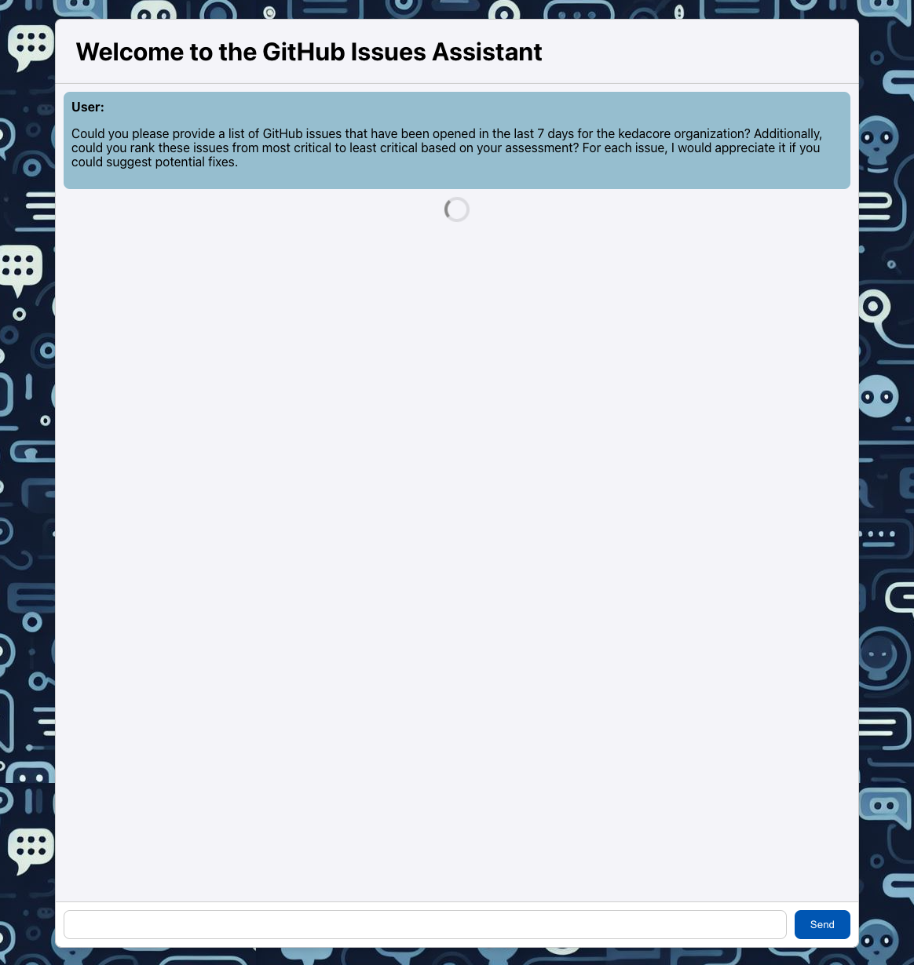


Function calling for stateful tools with durable
HTTP request with {prompt} to backend API
Orchestration of function calling performed by Azure AI Agent
“Could you please provide a list of GitHub issues that have been opened in the last 7 days for the <GITHUB> organization? Additionally, could you rank these issues from most critical to least critical based on your assessment? For each issue, I would appreciate it if you could suggest potential fixes.”
Queue
Generate Summary and Prioritize
Schedule GitHub Summaries Orchestrator
Apply to any scenarios that require durable execution, offering support for long-running processes and fault tolerance
Query new GitHub issues
Notes:
I'll start by extending the example that Eamon showed earlier where an agent can call a function via a tool.
The biggest thing I want to cover as we go back to that scenario – what if this function that your agent is calling, needs to be a little more complex than just calling an external API? What if it needs to call multiple functions, what if some of those calls need to do processing in parallel? And lastly, what if those tasks need to be fault-tolerant, meaning that if something like a failure form an outage of a downstream dependency went down, it can resume from its last successful point. Those are all great examples of when using Durable would be a perfect fit.

Slide 8
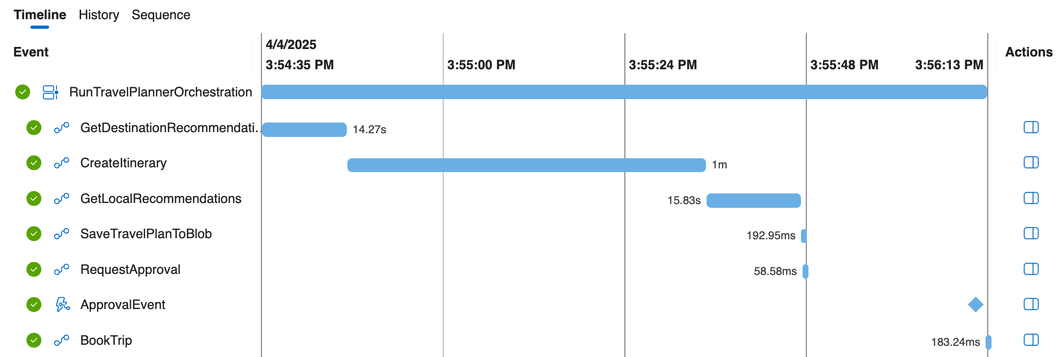
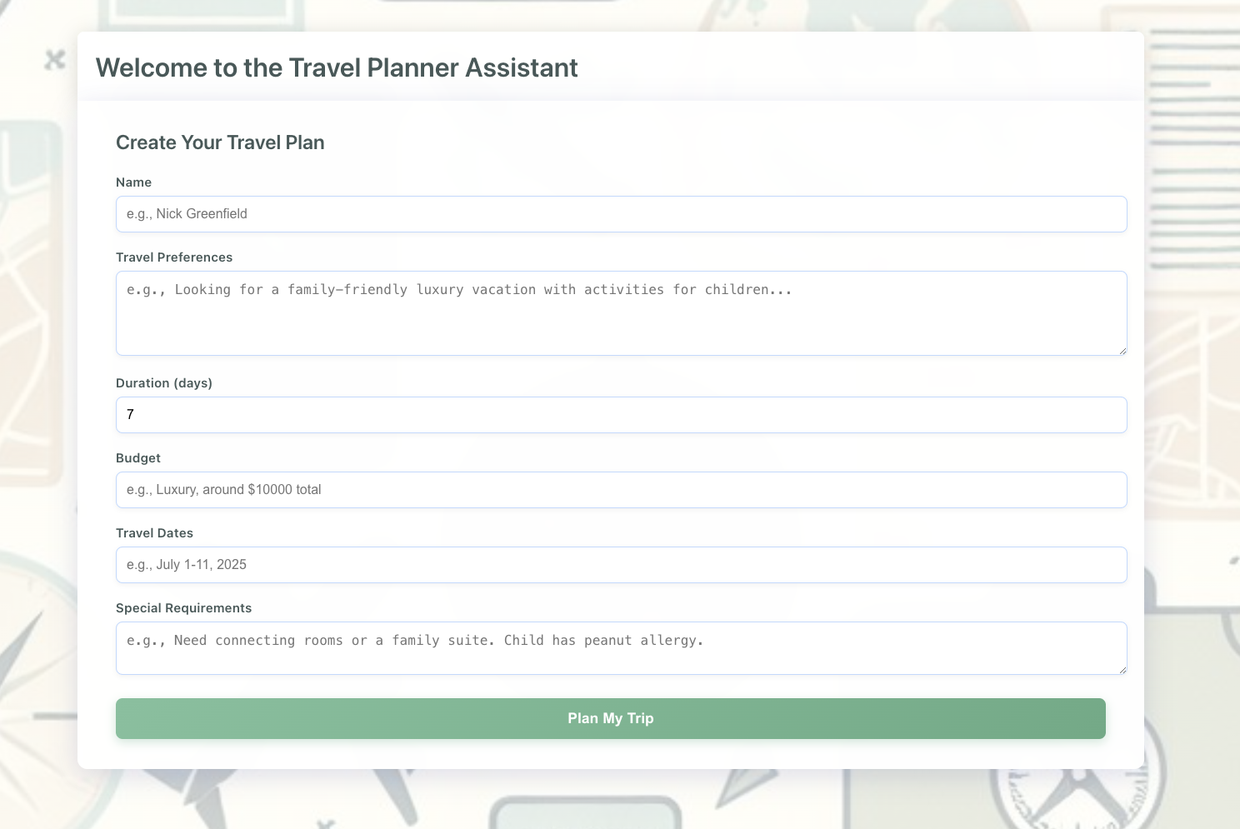

Directed agents with durable functions
Durable Task Scheduler Dashboard
for Orchestration Monitoring
Durable Function with Durable Task Scheduler
HTTP POST with User Input
Orchestrator (Travel Planner Orchestrator)
Activity Functions
Destination Recommender
AI Project Agent
Itinerary Planner
AI Project Agent
Local Recommendations
AI Project Agent
Upload Travel Plan To Storage
Blob Storage
Approve/Reject
Request Approval
Can be approved by the client or DTS dashboard
Booking System
(if approved)
Notes:
Next, I'll highlight how Durable Functions provide value when building an app that requires the orchestration of multiple agents to accomplish a larger task.
The app I'll demonstrate is an intelligent travel app, which follows a predefined format for travel planning,
<Talk about the scenario>
With Durable Functions, you benefit from their inherent durability. If one of the activity steps fails, the entire workflow doesn't need to restart, which could result in a different travel plan and itinerary. Instead, using Durable Functions ensures that the entire travel plan is persisted in the durable backend, allowing the workflow to resume from its last successful checkpoint.

Slide 9

Bring your own data in real time for semantic search (RAG)
https://github.com/Azure-Samples/azure-functions-openai-aisearch-python
Ask questions of documents
Retrieves organizations documents
Function processes organizations data
Function processes prompt and creates embeddings for this text
Stores extracted chunks and embeddings in semantic store
Searches semantic store using embeddings and retrieves related content
Extracts chunks from documents
Creates embeddings from chunks using OpenAI
Calls OpenAI with retrieved content and prompt

